Slide 1
O-list Retail and market analysis
- Rajdipa Mitra

Slide 2
Objectives
Data Cleaning and EDA
RFM on Customer behavior
Market Basket Analysis
Graphs Explaining the Market Behavior
Pareto Analysis (80:20 rule)
Actualize and Predicted Model
K-Means Clustering
Aprirori Rule for Categorization
Conclusion
Recommendations

Slide 3
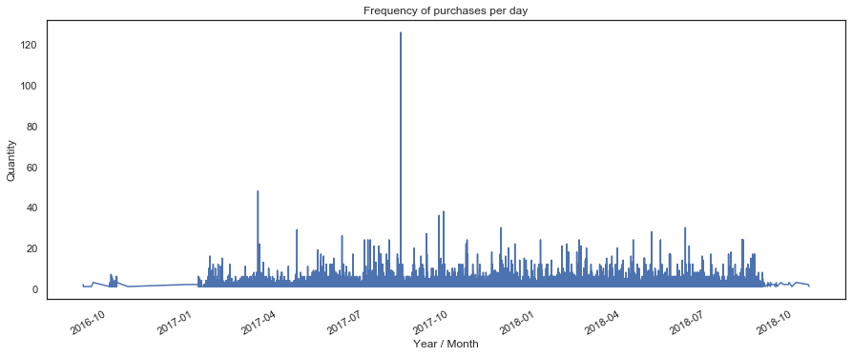
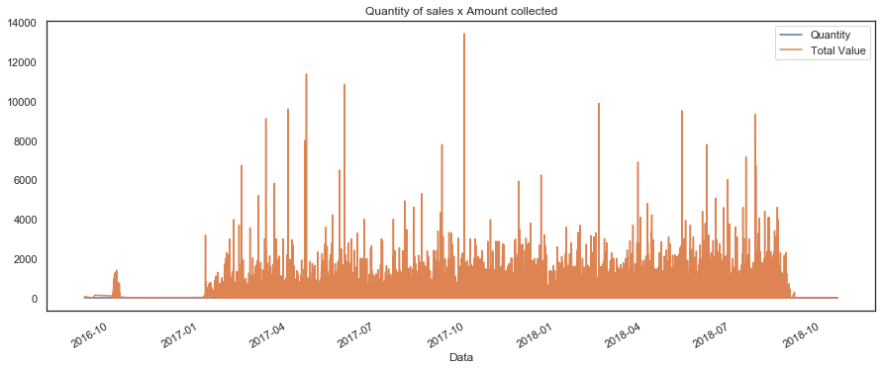
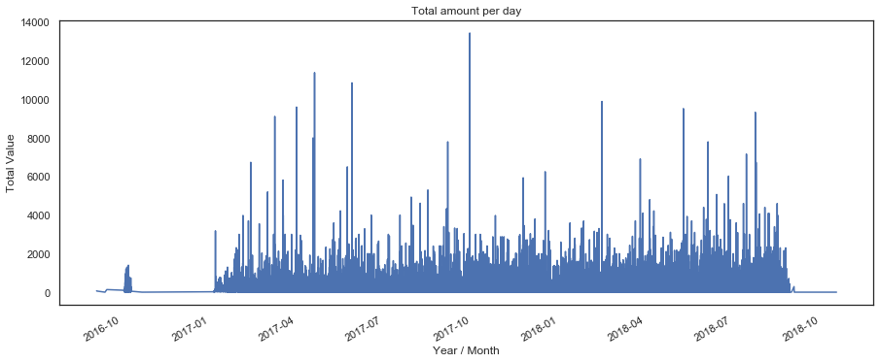
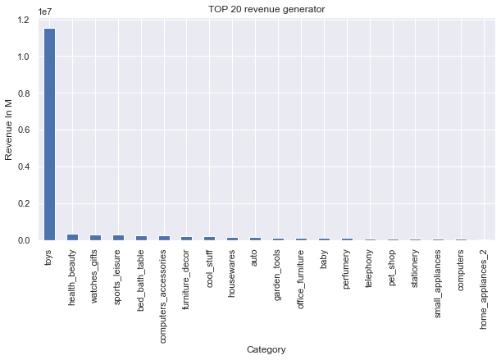
Sales Behavior
Notes:
First Graph shows the Frequency of the purchases
Second Graph shows the total amount of generated
revenue per day
Third Graph show the Quantity of the purchase
Fourth Graph is of the top 20 revenue generating
products

Slide 4
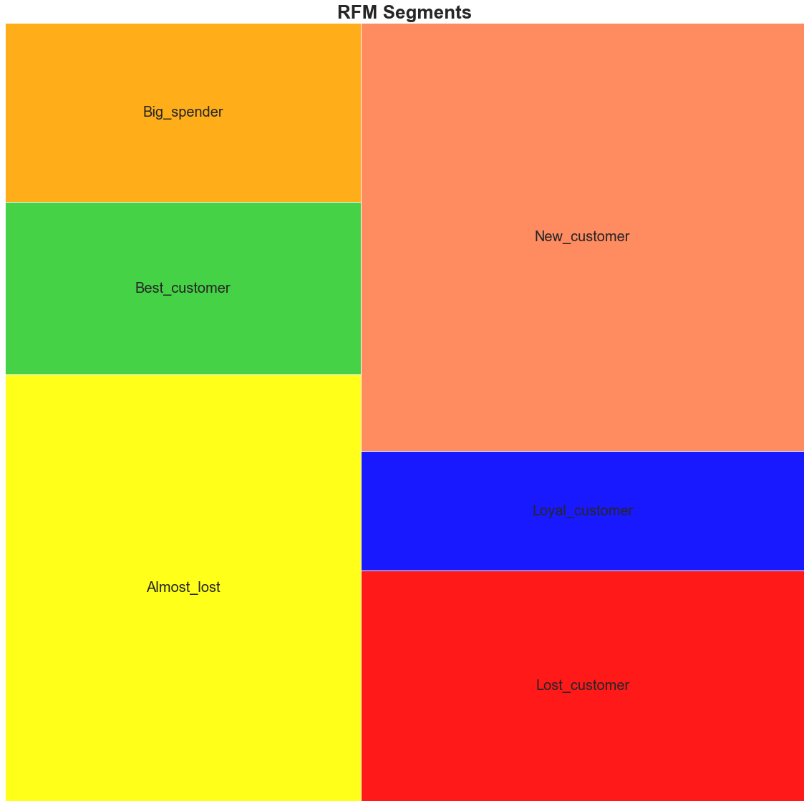
RFM Segmentation on Customer Behavior

Slide 5
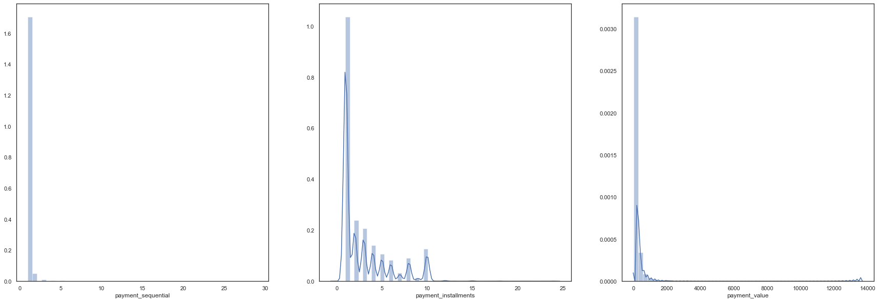
Payment Methods
Majority of the customers are inclined towards partial payment methods

Slide 6
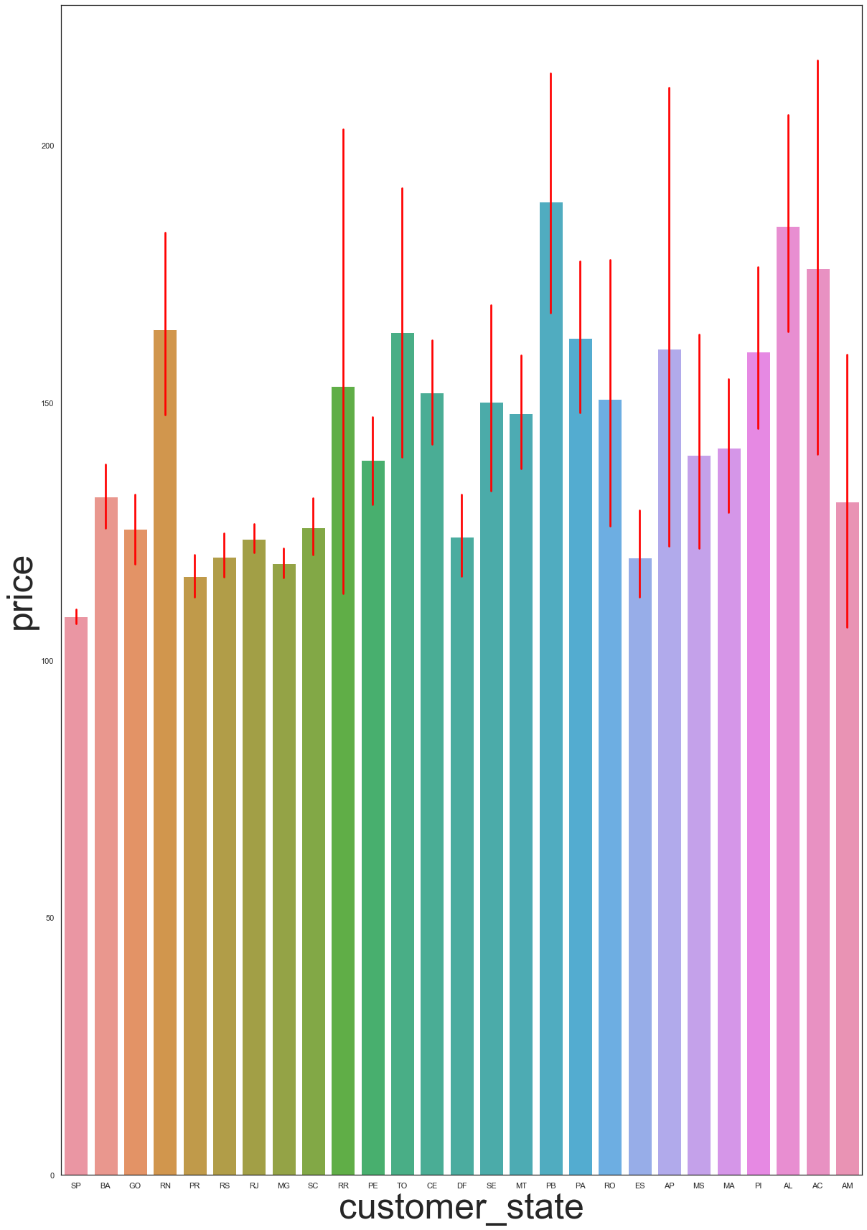
State Wise Customers’ Behavior

Slide 7
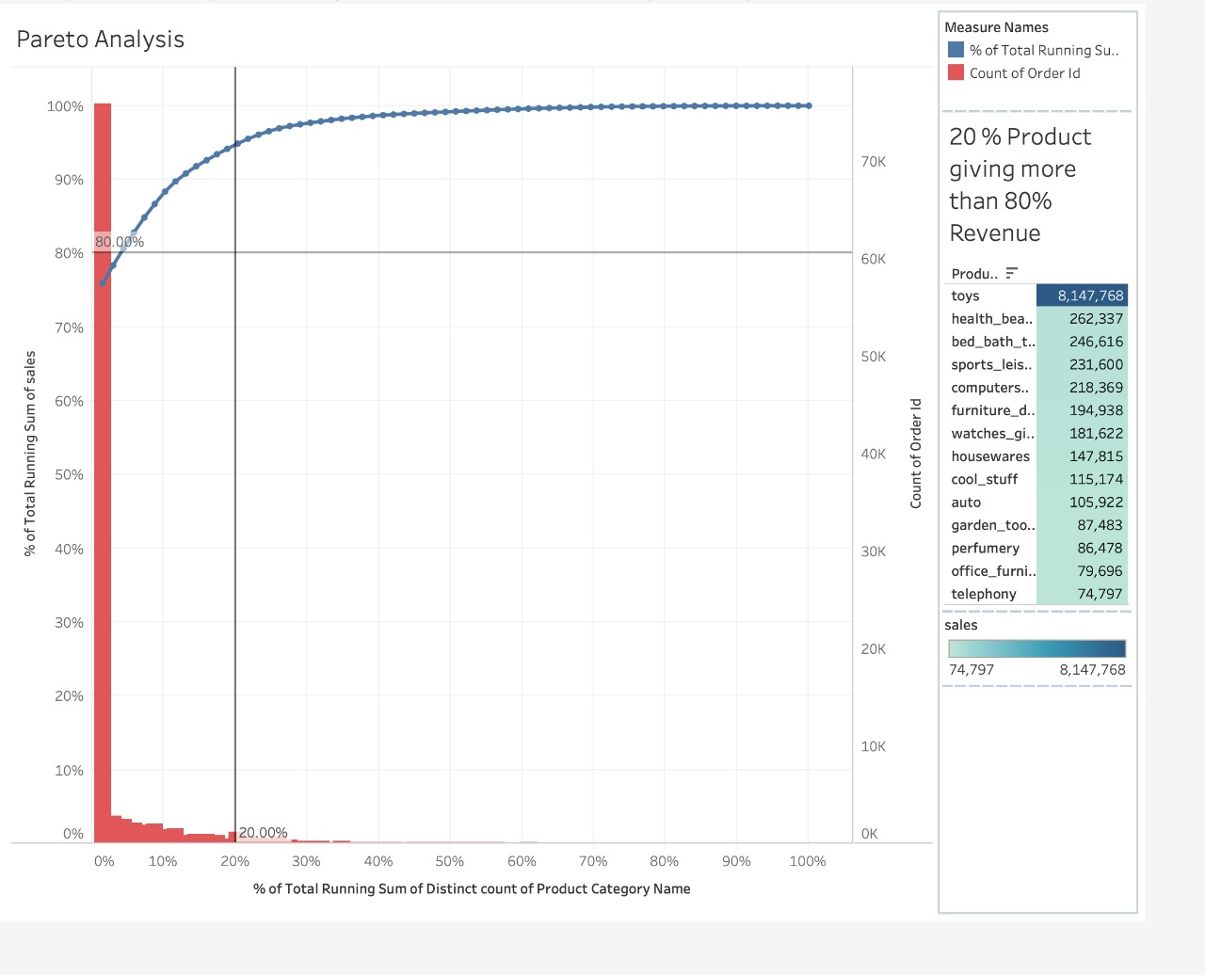
Pareto Analysis
Indeed 80% of the total revenue generators lies in the 20% of the product ”Toys”

Slide 8
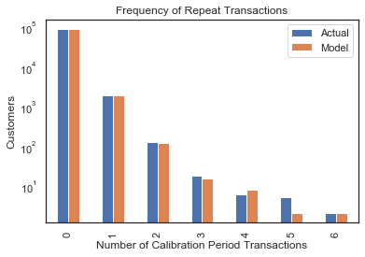
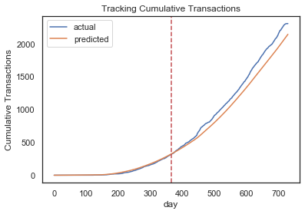
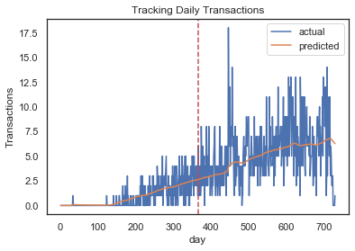
Cumulative transaction plot:
BG/NBD model does a pretty swell
job at predicting cumulative
transactions.
Calibration period histogram:
Shows the actual value precedes
The predicted
Incremental transaction plot:
This plot shows that the model
does a decent job capturing
general trends in the data.

Slide 9
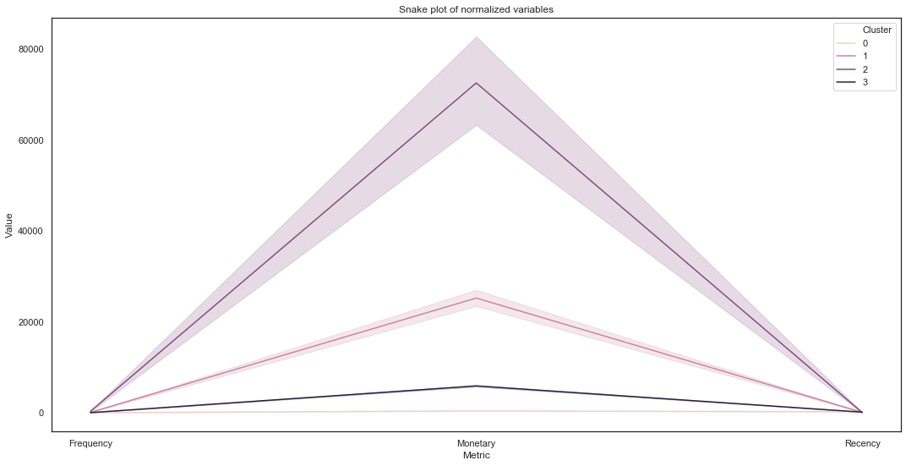
K-Means Clustering using Snake plot:-

Slide 10
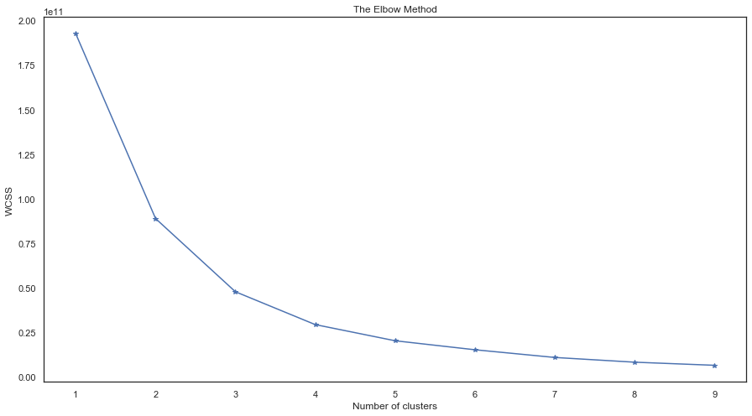
Clustering using elbow rule
We can see there is a sharp turn from the 4
point. We can select
values between 4 to 6 for our cluster

Slide 11
Apriori Analysis
Leverage formula
𝑙𝑒𝑣𝑒𝑟𝑎𝑔𝑒(𝑎𝑛𝑡𝑒𝑐𝑒𝑛𝑑𝑒𝑛𝑡,𝑐𝑜𝑛𝑠𝑒𝑞𝑢𝑒𝑛𝑡)=𝑠𝑢𝑝𝑝𝑜𝑟𝑡(𝑎𝑛𝑡𝑒𝑐𝑒𝑑𝑒𝑛𝑡,𝑐𝑜𝑛𝑠𝑒𝑞𝑢𝑒𝑛𝑡)−𝑠𝑢𝑝𝑝𝑜𝑟𝑡(𝑎𝑛𝑡𝑒𝑐𝑒𝑑𝑒𝑛𝑡)∗𝑠𝑢𝑝𝑝𝑜𝑟𝑡(𝑐𝑜𝑛𝑠𝑒𝑞𝑢𝑒𝑛𝑡)
leverage(antecendent,consequent)=support(antecedent,consequent)−support(antecedent)∗support(consequent)
Negative leverage means that the items appear together less frequently than we would expect if they were
randomly and independently distributed across transactions.

Slide 12
conclusion
As per the analysis, below mentioned are the insights
Toys which holds 20% of the items generates 80% of the revenue
18.4 % of the customers are recurring, whereas 40% of the customers are either lost or on the verge of leaving. Thus we need to look at the core issues, what is leading to this loss.
30.5 % of the customers have joined recently, adding upto a good amount of revenue
Looking at the purchases, Till now the most revenue was generated in the month of Oct,2017 with the largest quantity of sales
Based on Aprirori, categorisation of products been done. Hence, leading to easy and structured access of products on the app
Using K-means, we worked on Expectation Maximization, giving a best case scenario of 4 in Recency, Frequency and Monetary
Frequency Holdouts are in better stage wrt to Model Predictions

Slide 13
Recommendations
To add loyalty points/ benefits or regular customers in order to retain the customers
To add limited period offers, so that customer look forward to those catches
Categorization of products from sub-categories to Categories, for ease of access
To look at the state wise purchases and to apply similar approach for other states as well, in order to increase sales

Slide 14
Thank you

